Slide 1


Software Engineering
Spring’25
FAST-NU
Notes:
NOTE:
To change the image on this slide, select the picture and delete it. Then click the Pictures icon in the placeholder to insert your own image.

Slide 2
Scrum

Slide 3
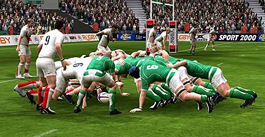

Slide 4
Scrum
Emphasizes use of a set of software patterns
Backlog
Sprints
Scrum meetings

Slide 5
Scrum
Scrum is framework for developing complex products and systems. It is grounded in empirical process and control theory. Scrum employs an iterative and incremental approach to optimize predictability and control risk.
Transparency
Adapt
Inspect

Slide 6
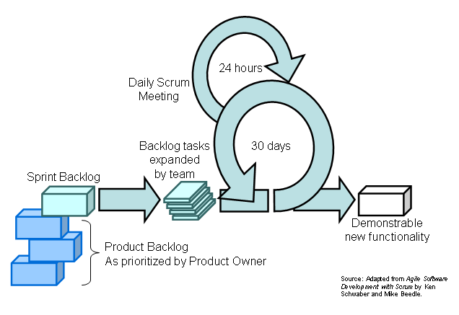
Scrum

Slide 7
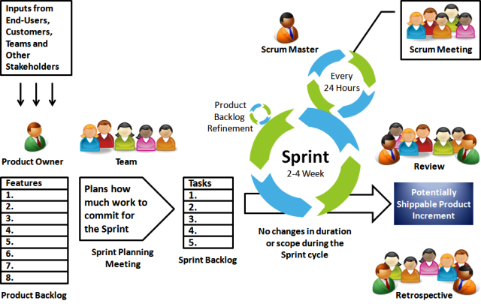

Slide 8
Product Owner decides what should be produced so as to achieve success
Gets inputs from users, teams, managers, stakeholders, executives, industry experts etc.
Produces the product backlog which contains the features of product to be produced in order of priority

Slide 9
The product backlog is the single master list of features, functionality etc ordered based on business value and risk.
The product backlog is constantly being revised by the product owner, to maximize the business success of the team’s efforts

Slide 10
Consists of 7 to 9 people
Team has to be cross functional- containing members from different verticals required for developing the product.
Team is self organized and self managing – makes a commitment and manages its responsibilities.

Slide 11
Sprints is referred to the fixed period of time the team commits to work in course of developing the product
The length of sprint is decided by the team and product owner
Working as sustainable pace is important to avoid burn out

Slide 12
Team selects what it will to deliver by the end of sprint.
Every member of team take part

Slide 13
Scrum’s Roles
The Product Owner(Project Sponsor, Decides features, release date, prioritization)
The Scrum Master (Facilitator) (-Typically a Project Manager or Team Leader
-Responsible for endorsing Scrum values and practices
-Remove weaknesses / politics, keeps everyone productive )
The Team
Everyone else is not part of Scrum

Slide 14
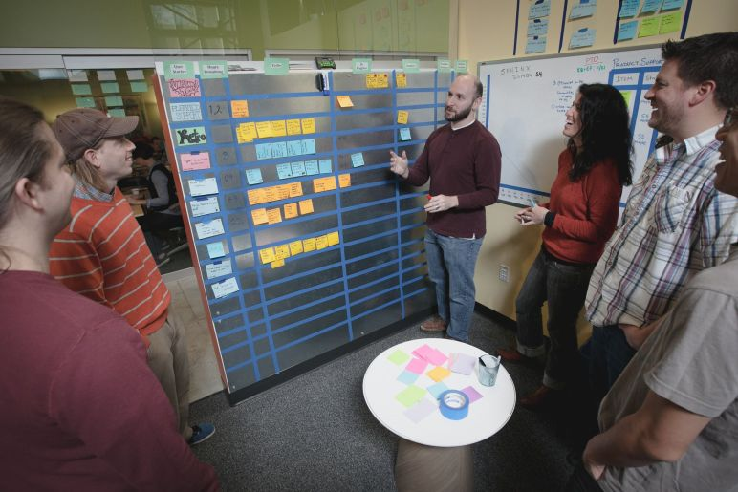

Scrum’s Practices
The Sprint Planning Meeting
The Sprint
The Sprint Review Meeting
The Daily Scrum
Everything else is not part of Scrum

Slide 15
The Sprint Planning Meeting
Product Owner describes highest priority features to the Team.
Team decides what they can commit to deliver in the Sprint.
Notes:
Nobody else can offer unsolicited advice: everyone else

Slide 16
The Sprint Review Meeting
Time boxed to one hour of prep and four hours of meeting.
Team demonstrates product increment to product owner’s satisfaction.
Informality is encouraged. PowerPoint is discouraged.

Slide 17
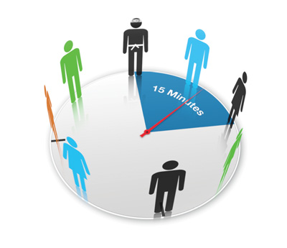
The Daily Scrum
Time boxed to fifteen minutes!
The Team and the Scrum Master only.
What have you accomplished since yesterday?
Are your Sprint Backlog estimates accurate?
What are you working on today?
Is there anything blocking you?

Slide 18
The Sprint Retrospective
Time boxed to three hours.
Team, Scrum Master, and (optionally) Product Owner review the last Sprint
What went well?
What can be improved?
Actionable items are presented to the Product Owner for prioritization as non-functional requirements.

Slide 19
Scrum’s Artefacts
The Product Backlog
The Sprint Backlog
The Sprint Burndown Chart
The Product Increment
Everything else is not part of Scrum

Slide 20
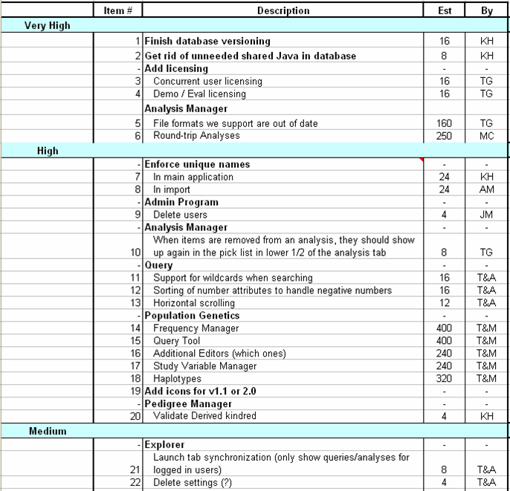
The Product Backlog

Slide 21
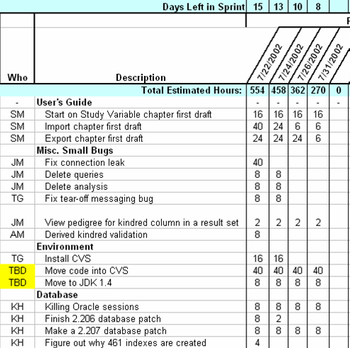
The Sprint Backlog

Slide 22
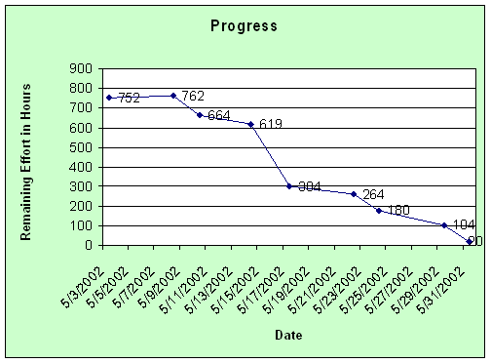
The Sprint Burndown Chart

Slide 23
The Product Increment
Delivers measurable value
“Potentially Shippable”: the process can be halted after every Sprint and there will be some value
Must be a product, no matter how incomplete
Notes:
Talk about training, QA

Slide 24
Some reasons to avoid Scrum
Your current software development produces acceptable results
Your project cannot be decomposed into good, increment-able requirements (“big ball of mud”)
Your engineering practices embrace heavy, up-front design, the construction of baroque frameworks, and throw-it-over-the-wall attitudes towards QA.
Nobody can agree on ‘done-ness’
Your management practices embrace ‘do it now and forget what I told you to do yesterday’.
Notes:
Your current process works fine – If your existing development method is already effective, switching to Scrum might not be necessary.
Your project is too messy ("big ball of mud") – If requirements are unclear and cannot be broken down into smaller parts, Scrum won’t work well.
Heavy, rigid engineering practices – If your team follows strict up-front planning and complex designs without iterative feedback, Scrum’s flexibility won’t fit.
No clear definition of "done" – If the team can’t agree on when a task is complete, Scrum’s sprint-based approach may cause confusion.
Chaotic management – If managers constantly change priorities and don’t follow structured planning, Scrum won’t be effective.

Slide 25
Difference between two agile processes
1. Scrum teams have sprint which are 2-4 weeks long whereas XP teams typically work in iteration no longer than 1-2 weeks long.
2. Scrum doesn't allow changes to the chosen sprint backlog once planned whereas XP teams are much more amenable to change within their iterations, but change can only be made if the team hasn't started working on a feature.
3. In Scrum product owner prioritizes the product backlog but the Scrum team can choose a lower priority item for a sprint to work on before the high priority work whereas XP teams must always work in priority order as Features to be developed are prioritized by the customer
The Biggest difference are
XP mandates a set of engineering practices where Scrum does not. At the same time Scrum mandates planning ceremonies and artifacts, where XP does not.

Slide 26
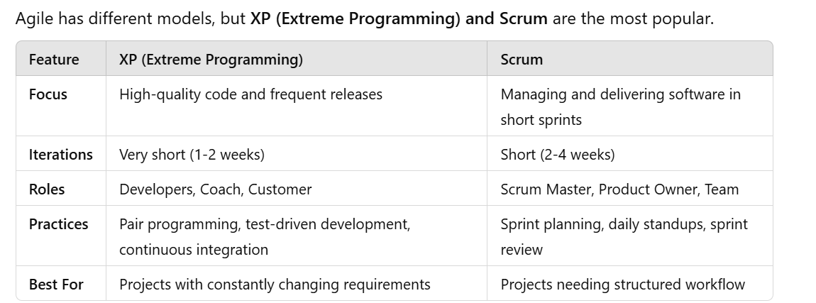

Slide 27
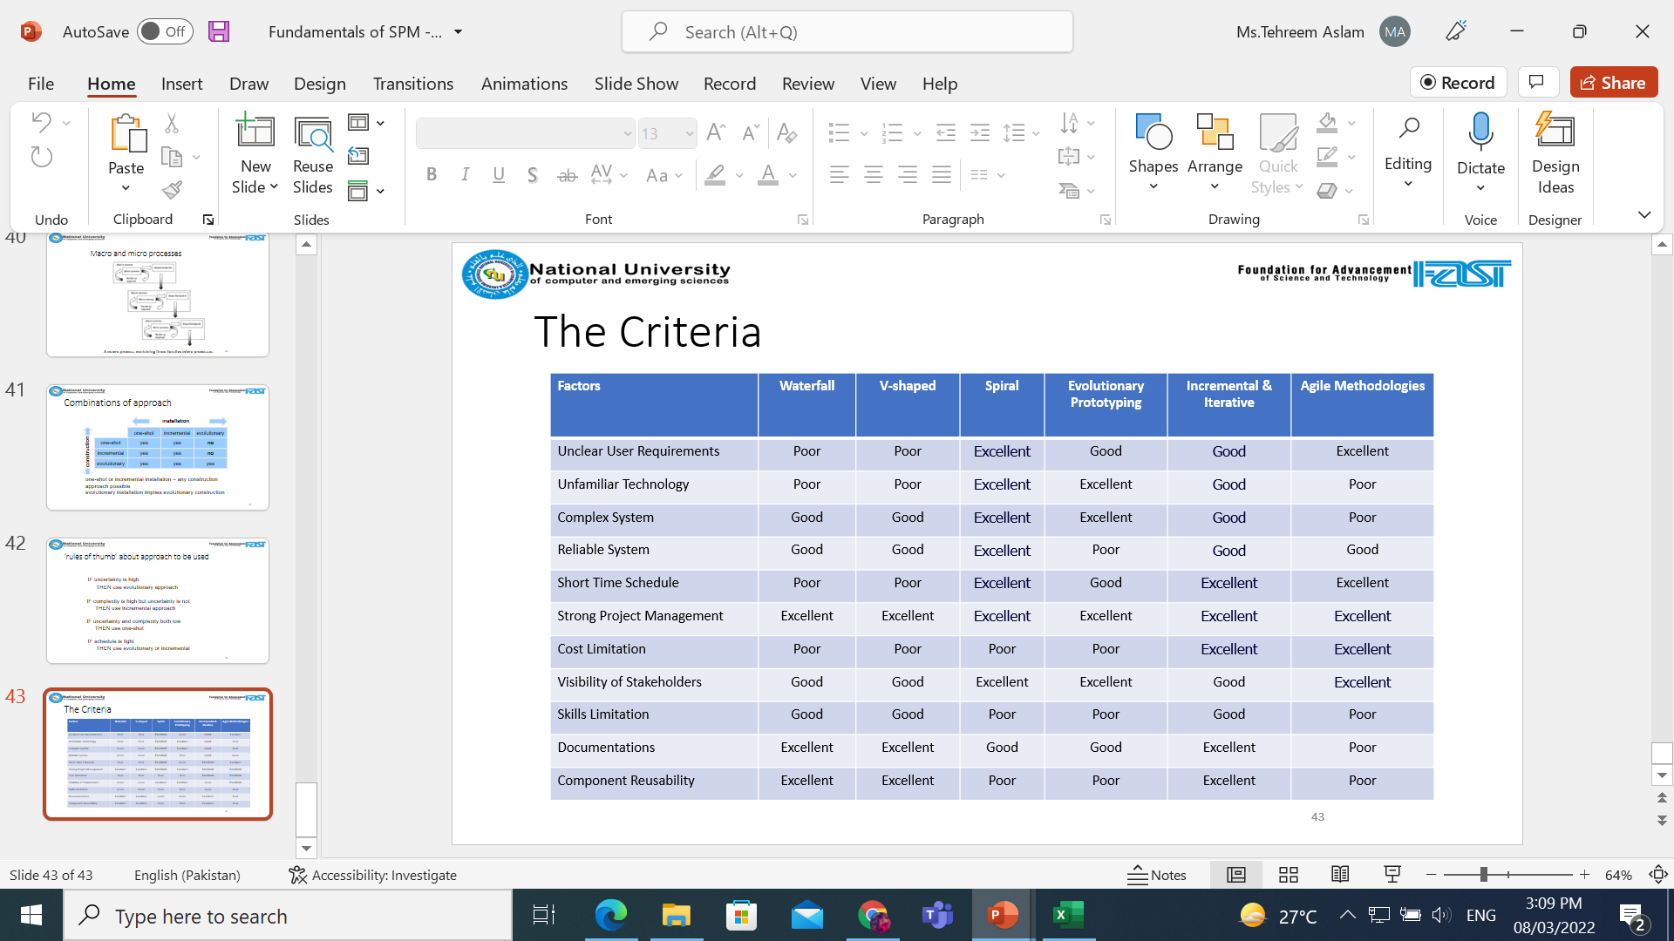
Criteria

